Slide 1
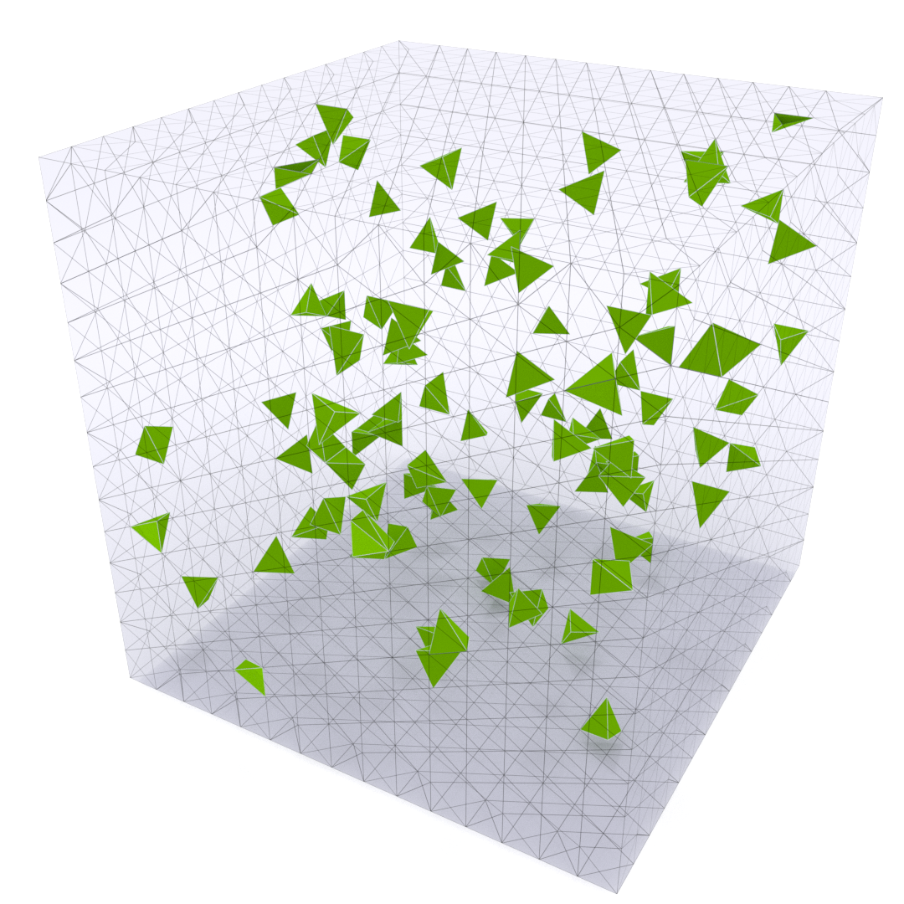
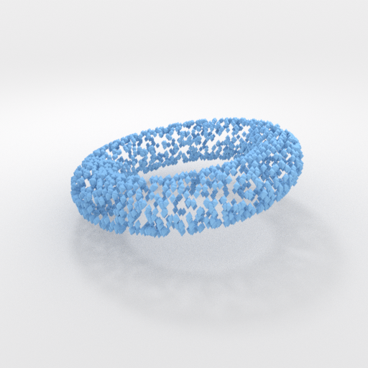

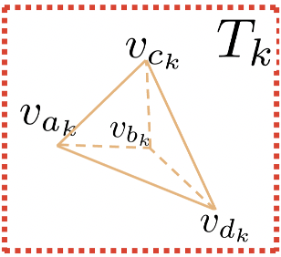
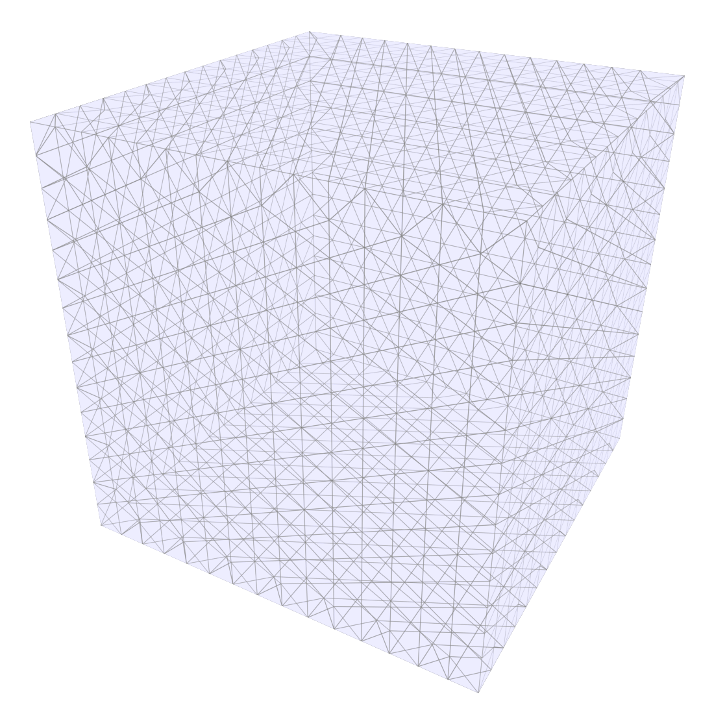

point cloud
Occupancy
NN Decoder
NN Encoder
Feature Volume
image
Deformation
Init Tetrahedral Mesh (uniformly spaced vertices)
Deformed Tetrahedral Mesh with predicted occupancy
Input

